Slide 1

All About France

Slide 2

Bonjour!
Ca va?
Salut
Ça va bien

Slide 3

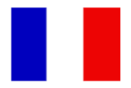

Slide 4
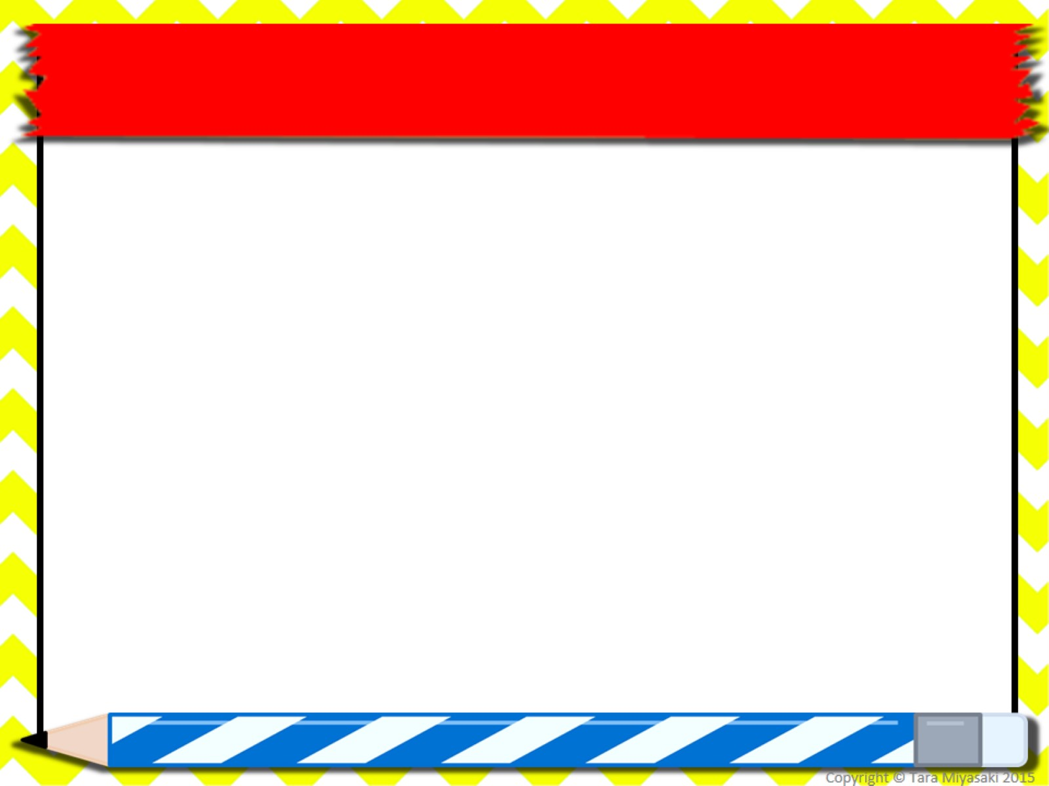
Facts about France:
Capital City: Paris
Population: 66,259,012
Language: French
Currency: Euro
Area: 210,026 square miles (543,965 square kilometres)
Major mountain ranges: Alps, Pyrenees, Massif Central
Major rivers:: Seine, Rhine, and Rhône

Slide 5

Two thirds of France is mountains and hills, with the Alps, Pyrenees and Vosges ranges. Mont Blanc in the Alps is the highest mountain in Europe.

Slide 6
Climate: Mild winters and cool summers in much of the nation; warmer winters and hot summers along the Mediterranean coast
Major cities and population: Paris - 8.7 million people, Lyon - 1.2 million, Marseille - 1.2 million, Lille - 950,000 and Bordeaux - 640,000.

Slide 7
In the past, agriculture was one of France's major industries. France is still a leading producer of wine.
Today the economy is much more industrialized. The French industry produces cars, aerospace products, and other manufactured goods. It is also a major producer of chemical products. Fashion, textiles and tourism also play a significant role in the French economy.

Slide 8
Art and culture are an important part of France. Many famous artists, such as Renoir and Monet, are from France. Several famous writers, including Victor Hugo who wrote Le Miserables and the Hunchback of Notre Dame, are from France.

Slide 9

Symbols such as the Eiffel Tower, the Louvre, the Cathedral of Notre Dame, the Latin Quarter, Montmartre, and the Georges Pompidou Centre make Paris one of the most visited places in the world

Slide 10

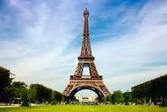

Slide 11
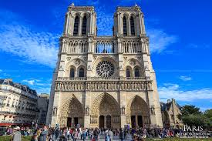

Slide 12
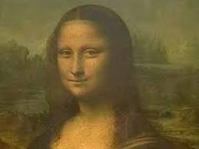

Slide 13

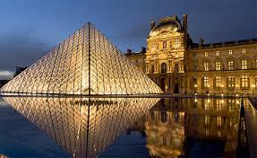

Slide 14
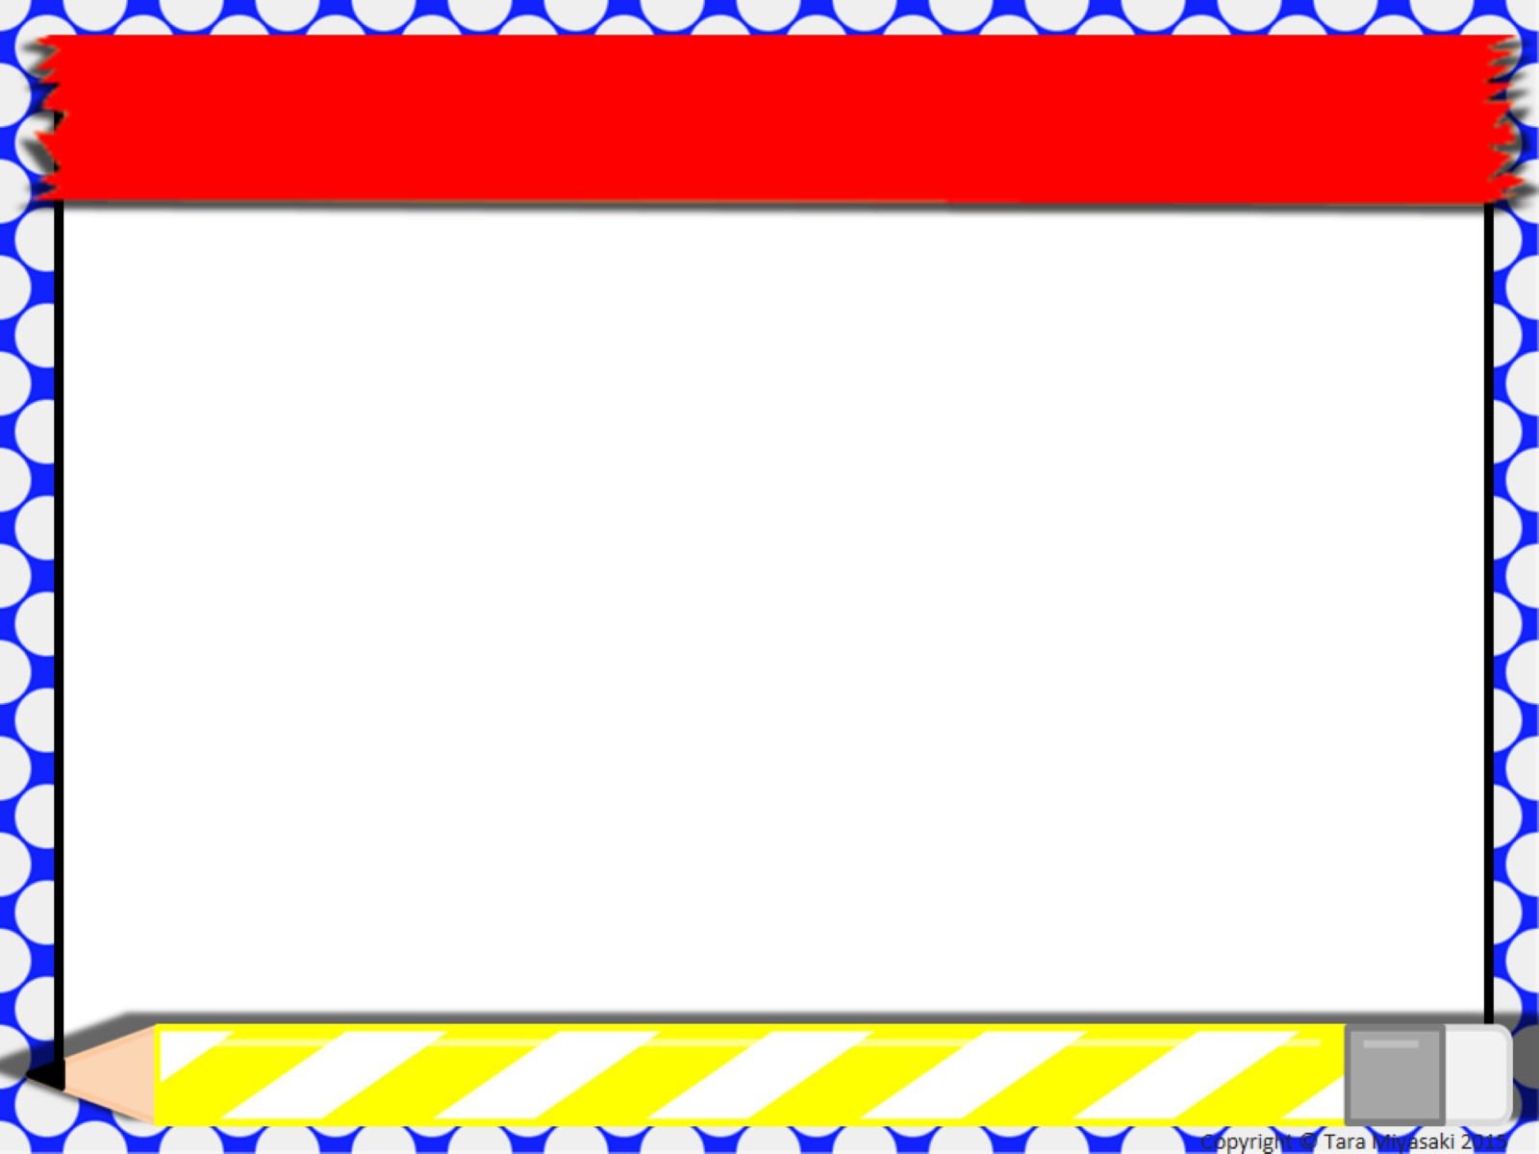
France is famous for cheese (Camembert, Brie, Roquefort) wine, perfume
(Chanel, Dior, Givenchy) and cars (Renault, Citroen, Peugeot).France is also famous for the Tour de France.

Slide 15
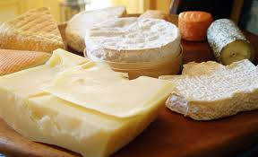

Slide 16
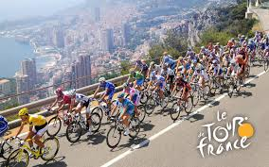

Slide 17

France is known for its fine food. French cooking is thought to be the best in the world. Chefs prepare dishes such as quiche, soufflés, mousse, pâté, croissants, crêpes, and French bread. Many people in France like to drink their hot chocolate from bowls and dip their bread into it.

Slide 18

Famous French People:
Claude Monet:
Artist: The leading member of the Impressionist painters. His most famous painting is the "Water-lilies" which he painted in the elaborate garden he had made for himself.

Slide 19
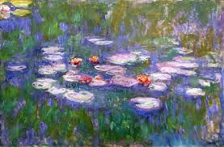

Slide 20
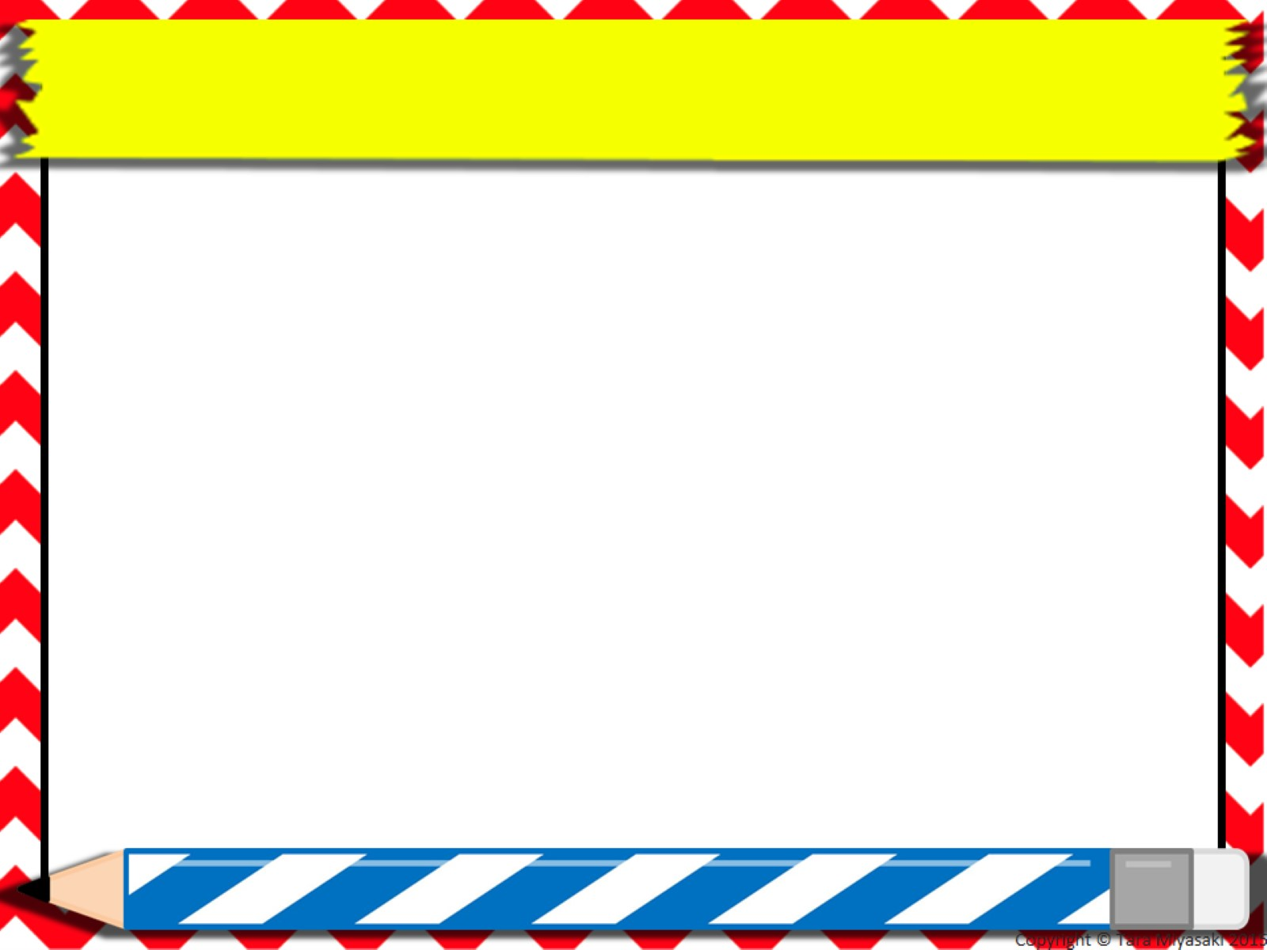
Camille (Charles) Saint-Saëns (1835-1921)
Musician: A French composer who is well known for "The Carnival of the Animals" a composition for orchestra, piano, xylophone and harmonica.

Slide 21

Victor Hugo (1802-1885)
Author: He wrote the well known novel "The Hunchback of Notre Dame" and in 1862 the epic novel "Les Miserables"

Slide 22

Jeanne d'Arc Joan of Arc (1412-1431 approx.)
Warrior: The patron saint of France and a national heroine who led the resistance to the English invasion of France in the Hundred Years War.

Slide 23
Napoléon Bonaparte (1769-1821)
Emperor: A famous French general who became Emperor of France in the aftermath of the French Revolution

Slide 24
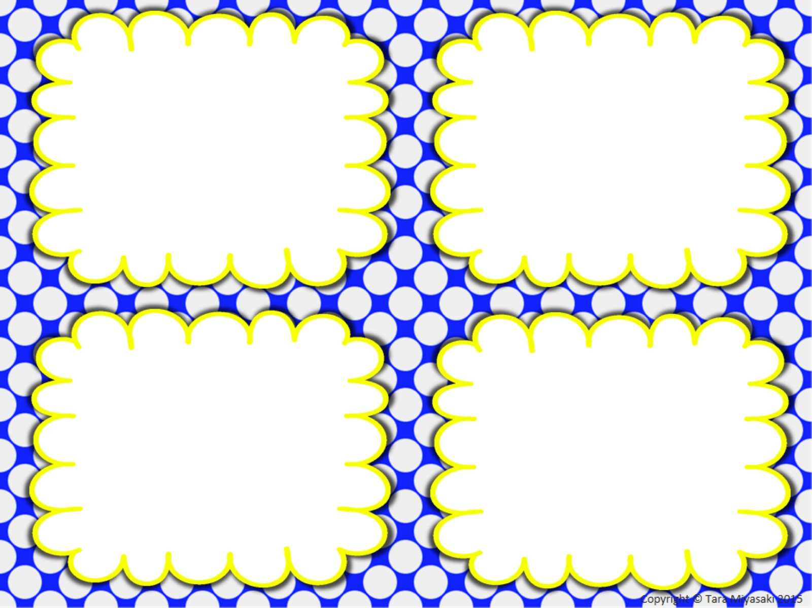
Can you tell me the name of the capital city of France?
Can you tell me the name of the longest river in France?
Can you tell me the name of a mountain range in France?
Can you tell me anything about the climate in France?

Slide 25

Can you name a famous French painter?
Can you name a famous French composer?
Can you name a famous French author?

Slide 26


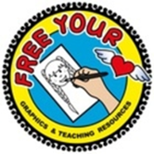


Created by Valerie King
Power-point template: Tara Myasaki
Clipart:

