Slide 1
To Do Lists

Slide 2
My Daily To Do List:

Slide 3
To Do Lists:
To Copy:
To Correct
To Print
To File
To Organise
To Send Home

Slide 4
Daily To Do List

Slide 5
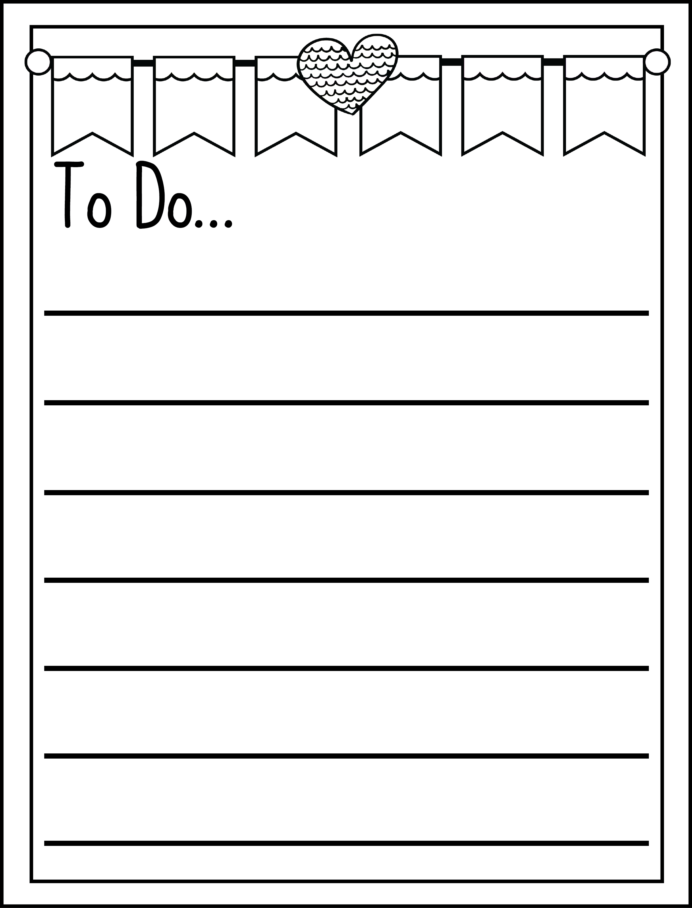

Slide 6
To Do List:

